Slide 1
Intro to Frankenstein
Romantic and Gothic Elements

Slide 2
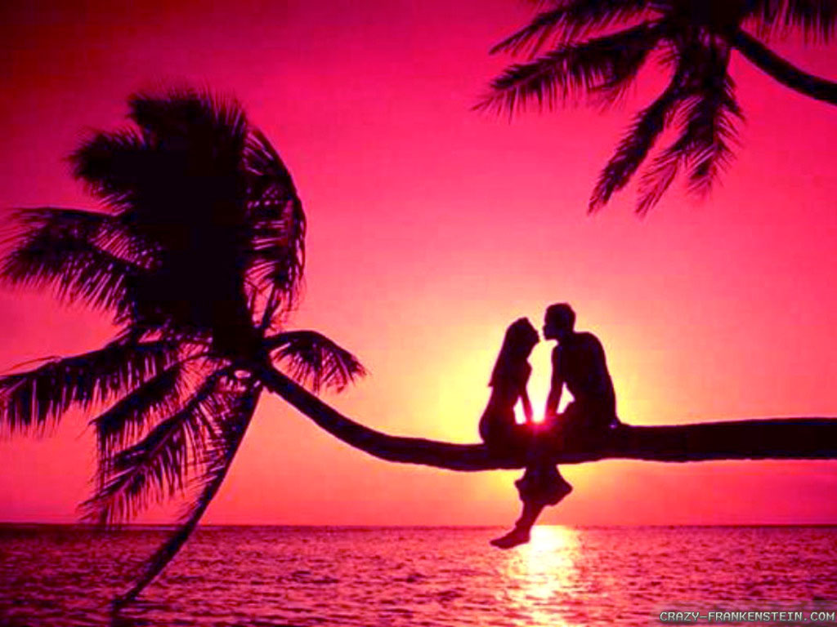
Romanticism
Not really about this

Slide 3
Romanticism is more so about this...
Movement contrary to Enlightenment and Industrialization
The Enlightenment and Industrialization emphasized how man’s reason and logic can improve society
Romanticism emphasized the importance of the individual, subjectivity, imagination, and expression of emotions

Slide 4
Romanticism
Romantics were tired of being oppressed by tyrant rulers.
The time period is simultaneous with the French and American revolutions
Nature imagery is a key element in Romantic literature
Human tyranny cannot control nature
Nature represented peace
Emotional healing comes from peace

Slide 5
Gothic Literature
Not about people like this

Slide 6
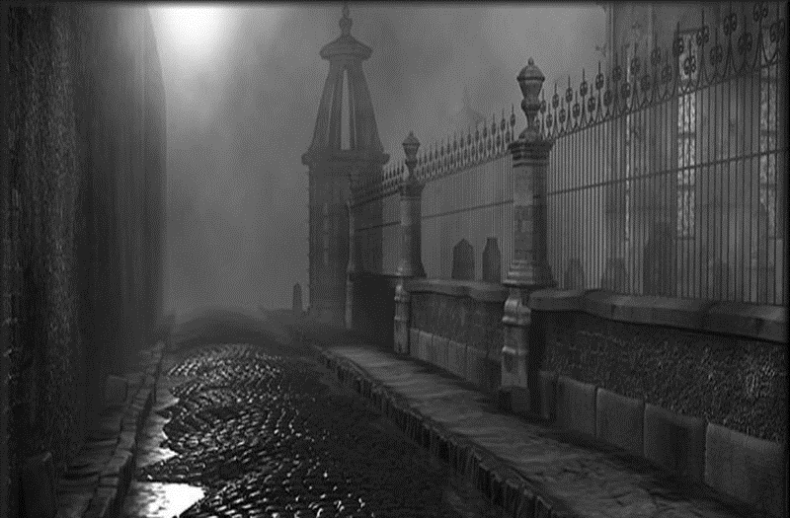
Gothic Literature
More about settings like this

Slide 7
Elements of a Gothic Novel
•An atmosphere of mystery and suspense
•Gruesome deaths
•Omens, portents, visions
•Supernatural or otherwise inexplicable events
•High, even overwrought emotion
•Women in distress
•Women threatened by a powerful, impulsive, tyrannical male
•Metonymy of gloom and horror
•Vocabulary of the gothic

Slide 8
Gothic Literature
Contrary to the Romantics, Gothic writers gave nature the power of destruction
Pathetic fallacy - what do you think would happen in the novel when there is a storm in the background?

Slide 9
Frame Story
A story that exists within another.
Forrest Gump, Slumdog Millionaire, and The Notebook are popular frame stories.
Forrest narrates many stories from the park bench, then eventually leaves the bench to continue the actual story of the film
In Slumdog, as Jamal gets closer to the million dollar question, he has different stories for why he knows each answer

Slide 10
Frankenstein’s Frame Story

