Slide 1
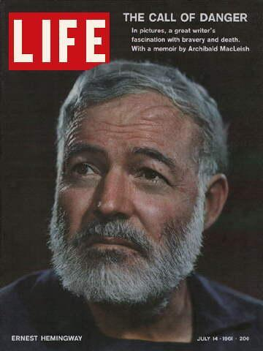
Introduction to Hemingway Style
Hint Fiction and Making Inferences

Slide 2
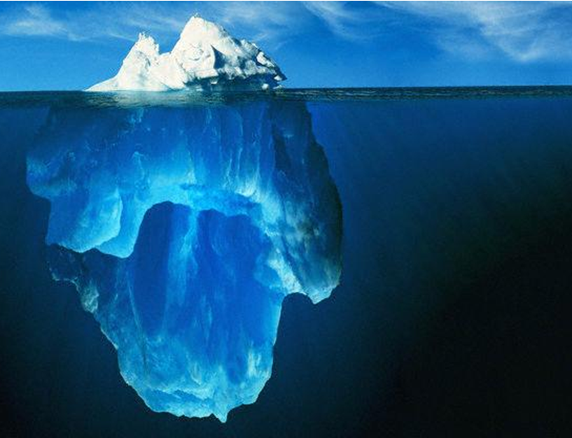
Hemingway’s Iceberg Theory
On the surface, Hemingway’s writing is typically:
Concise – it says a lot with just a few words
Rhythmic
Authentic – it’s true to real life
Clear
Immediate – it’s written “here in the moment”
Objective – it sticks to the facts; it lets the reader interpret
Interpreting Hemingway’s writing requires the reader to examine the selection for:
Symbols
Allegories
Tone / Mood
Setting
Literary Devices
Word Choice / Diction
Sentence Structure

Slide 3
Hint Fiction
What is Hint Fiction?
  A story of 25 words or fewer that suggests a larger, more complex story.
  It’s not an attempt at writing a full story.
  It’s not simply what would be the first line or two of a longer story.
  It’s not a poem.
  It should not be completely straightforward.

Slide 4
Hint Fiction
The best examples…
    Have multiple possible meanings that can be discovered when you think and talk about the story more.
    Use each word skillfully – nothing is wasted.
    Many times use a title to add to the story, perhaps giving a clue to the meaning or possibly adding to the possible ambiguity.

Slide 5
Hint Fiction – Connection to Hemingway
Why are we studying it?
  Hemingway (the author we’re studying next), is a man of few words. He is known for his brevity in his writing and the need to have to look beneath the surface in order to truly understand his stories.
  Legend had it that Hemingway was in a bar and challenged by fellow writers to come up with the shortest story possible. Here is what he came up with:
For sale: baby shoes, never worn.
  You MUST infer, read into the story, and consider alternate interpretations within the hint fiction story.

Slide 6
Hint Fiction
As we read the following pieces of Hint Fiction, respond to each in your notebook. Make inferences and explain your interpretation based on the clues given to you in the story. (2-3 sentences each)

Slide 7
Hint Fiction
“Pregnancy Test” by Jennifer Haddock
A drop of pee. An unanswered prayer. The second pink line draws one childhood to an end as another begins.

Slide 8
Hint Fiction
“The Day After” by Brian Crawford
He started to put the cover back on the pool but stopped. What was the point? He had needed it yesterday.

Slide 9
Hint Fiction
“Blind Date” by Max Barry
She walks in and heads turn. I’m stunned. This is my setup? She looks sixteen. Course, it’s hard to tell, through the scope.

Slide 10
Hint Fiction
  “House Hunting” by Gary A. Braunbeck
The fence is tall. Good. The mother is typical white trash, too loud. But the kids…they seem frightened and quiet. Good. Easier that way.

Slide 11
Hint Fiction
“Visiting Hour” by Katrina Robinson
She placed her hand over his and pressed the pen to paper. The signature looked shaky, but it should be enough.

Slide 12
Hint Fiction - On Your Own…
Your Own Story:
  See how simple this is?! For homework tonight, you must write your own Hint Fiction stories. It will be read by others. It must be on a separate piece of paper than today’s story responses. Have fun and be creative!

