Slide 1
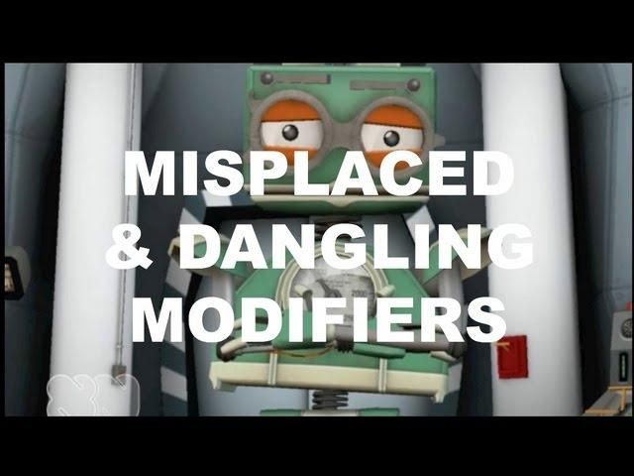
Take notes on the following video...

Slide 2
What are they?
Modifiers are just what they sound like—words, phrases, or clause that modify (describe or change the meaning) of another word, phrase, or clause.
Misplaced Modifiers are modifiers that modify something you didn't intend them to modify. For example:
I almost failed every art class I took.
I failed almost every art class I took.

Slide 3
Dissecting the sentences...
What is the modifier in each sentence?
I almost failed every art class I took.
I failed almost every art class I took.
Notes:
1. Almost and every 2. a. almost FAILED every ART CLASS b. almost every ART CLASS

Slide 4
Dissecting the sentences...
What is the modifier modifying (describing) in each sentence?
I almost failed every art class I took.
I failed almost every art class I took.
Notes:
1. Almost and every 2. a. almost FAILED every ART CLASS b. almost every ART CLASS

Slide 5
Dissecting the sentences...
What is the modifier modifying (describing) in each sentence?
I almost failed every art class I took.
I failed almost every art class I took.
Modifiers describe the words/phrases
directly following them.
Notes:
1. Almost and every 2. a. almost FAILED every ART CLASS b. almost every ART CLASS

Slide 6
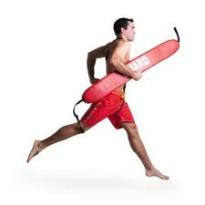
Let’s Try, Again!
Underline the modifier. Then, circle and draw an arrow to what it modifies.
He nearly swam for an hour.
He swam for nearly an hour.

Slide 7
Let’s Try, Again!
Underline the modifier. Then, circle and draw an arrow to what it modifies.
He nearly swam for an hour.
He swam for nearly an hour.

Slide 8
Misplaced Modifiers
We need to be careful that modifiers are modifying the intended words.
Which is mostly likely the intended meaning?
He nearly swam for an hour.
He swam for nearly an hour.

Slide 9
Fix the Misplaced Modifier
1.I nearly made $100.00 today.
2.When we opened the leather woman’s purse, we found the missing keys.
3.The job scarcely took an hour to complete.
4.I only have five minutes to talk with you.
5.The striking Honda’s paint job made everyone gasp.

Slide 10
Corrected Misplaced Modifiers
1.I made nearly $100.00 today.
2.When we opened the woman’s leather purse, we found the missing keys.
3.The job took scarcely an hour to complete.
4.I have only five minutes to talk with you.
5.The Honda’s striking paint job made everyone gasp.

Slide 11
Misplaced Modifiers (Phrases/Clauses)
When you place a phrase or clause in the wrong place, all sorts of funny things can happen. Be careful!
Christine made the brownies for her aunt with chocolate icing.
What is a woman doing running around covered in chocolate icing?
Christine made brownies with chocolate icing for her aunt

Slide 12
Fix the Misplaced Modifier
1.The fans stood in line to buy tickets for the show for twenty minutes.
2.Marian read a chilling article in The New York Times about the effects of mercury poisoning.
3.The salesman sold the picture to that woman in the silver frame.
4.We gave the old clothes to a local charity that had been piled up in the basement.
5.The grass that was covered by the snow was creating a lush carpet of green.
6.The terrified patient spoke to the doctor with a terminal disease.
7.The student pleaded with the instructor who cheated on the test.

Slide 13
And the answers are...
1.The fans stood in line for twenty minutes to buy tickets for the show.
2.In The New York Times, Marian read a chilling article about the effects of mercury poisoning.
3.The salesman sold the picture in the silver frame to that woman.
4.We gave the old clothes that had been piled up in the basement to a local charity.
5.The grass that was creating a lush carpet of green was covered by the snow.
6.The terrified patient with a terminal disease spoke to the doctor.
7.The student who cheated on the test pleaded with the instructor.

Slide 14
Dangling Modifiers
Dangling Modifiers modify a subject not stated in the main clause.
They are at the beginning of a sentence and separated from the main clause by a comma.
Example: Having arrived late for practice, a written excuse was needed.

Slide 15
Dangling Modifiers
Underline the modifier, and circle what it is modifying.
Having arrived late for practice, a written excuse was needed.

Slide 16
Dangling Modifiers
Underline the modifier, and circle what it is modifying.
Having arrived late for practice, a written excuse was needed.
This sentence is saying a written excuse arrived late for practice.

Slide 17
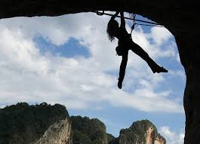
Correcting Dangling Modifiers
To correct Dangling Modifiers, we often need to slightly rewrite the sentence.
There are 3 rules that will help you correct Dangling Modifiers.
Let’s Get Started!

Slide 18
Correcting Dangling Modifiers
Rule # 1 : Name the appropriate subject of the action as the subject of the main clause
Having arrived late for practice, a written excuse was needed.
Having arrived late for practice, Tommy needed a written note.

Slide 19
Your Turn!
Fix the Dangling Modifier using Rule #1
After reading the original study, the article remains unconvincing.
Hint: Identify an appropriate subject in the main clause.

Slide 20
Your Turn!
Fix the Dangling Modifier using Rule #1
After reading the original study, the article remains unconvincing.
After reading the original study, I find the article unconvincing.

Slide 21
Correcting Dangling Modifiers
Rule # 2 : Name the subject of the action in the introductory clause.
Without knowing his name, it was difficult to introduce him.
Because Maria didn’t know his name, it was difficult to introduce him.

Slide 22
Your Turn!
Fix the Dangling Modifier using Rule #2
After reading the original study, the article remains unconvincing.
Hint: Add the subject to the introductory clause.

Slide 23
Your Turn!
Fix the Dangling Modifier using Rule #2
After reading the original study, the article remains unconvincing.
After I read the original study, the article remains unconvincing.

Slide 24
Correcting Dangling Modifiers
Rule # 3 : Combine the phrase and main clause
To improve his results, the experiment was done again.
He improved his results by doing the experiment again.

Slide 25
Your Turn!
Fix the Dangling Modifier using Rule #3
After reading the original study, the article remains unconvincing.
Hint: Add the subject to the beginning and move the modifier to the end of the sentence.

Slide 26
Your Turn!
Fix the Dangling Modifier using Rule #3
After reading the original study, the article remains unconvincing.
I think the article remains unconvincing after reading the original study.

Slide 27
Fix the Dangling Modifier
Fix the Dangling Modifier and label which rule was used.
1.Leaving quickly, my car lights were left on.
2.After explaining that I had lost my wallet, the waiter allowed me to pay by check.
3.To complete a degree in anthropology, at least two history courses must be taken.
4.Once filled with ink, Gina can write for hours before the pen runs dry.
5.In selecting her next car, cost was determined by Linda’s paycheck.

Slide 28
Practice
Worksheet

