Slide 1
Modernism & The Great Gatsby

Slide 2
Modernism & the Modern Novel
Refers to the radical shift in aesthetic and cultural sensibilities evident in the art and literature after World War I
Marks a distinctive break with Victorian bourgeois morality
Rejects nineteenth-century optimism
Presents a profoundly pessimistic picture of a culture in disarray
Results in an apparent apathy and moral relativism.

Slide 3
Modernist Authors
Introduced a variety of literary tactics and devices
Derided for abandoning the social world in favor of its narcissistic interest in language and its processes
Recognized the failure of language to ever fully communicate meaning
Downplayed content in favor of an investigation of form.

Slide 4
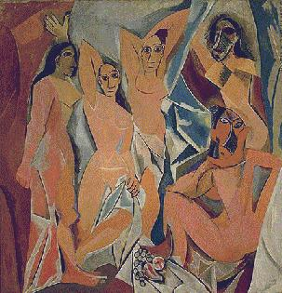
Modernist Authors
Believed modern life was radically different from traditional life
More scientific, faster, more technological, and more mechanized
Embraced these changes
Technological innovation inspired new attentiveness to technique in the arts
Vision and viewpoint an essential aspect

Slide 5
Modernist Authors
Unacceptable to write a straightforward third-person narrative
Method of telling story as important as the story itself
Experimented with fictional points of view
Often restricted the information in the novel to what a single character would have known
Analysis of modernist novels called for new methods of criticism

Slide 6
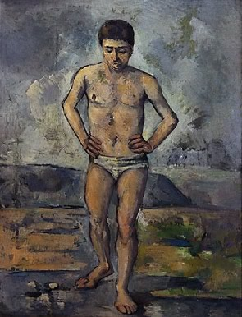
Modernist Authors
Created new critical vocabulary
Hunted for the "epiphany" (moment in which a character suddenly sees the transcendent truth of a situation)
Examined and clarified a work
Hoped to shed light upon through insights

Slide 7
Characteristics of Modernism
Representation of the world through the mysterious symbol
The independence of art and its divorce from truth or morality
The depersonalization and “objectivity” of art
Illogical structure
The concrete as opposed to the abstract
The particular as opposed to the general
The perceptual as opposed to the conceptual
Verbal ambiguity and complexity
Stream of consciousness
The emphasis on the divided self
The dissatisfaction of the individual in the “lonely crowd”
The alienated self in the urban world

Slide 8
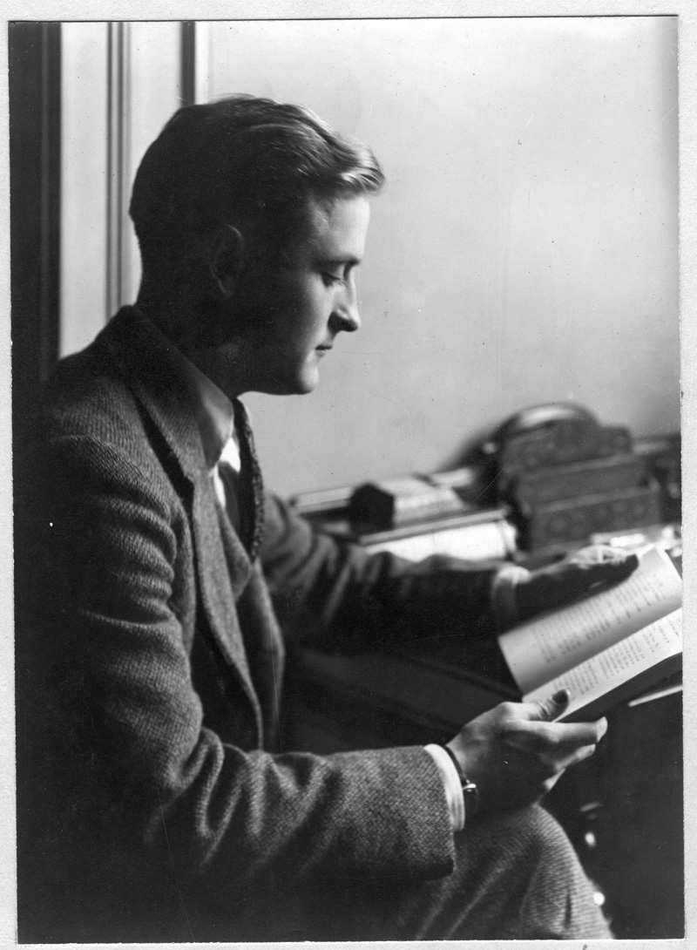
F. Scott Fitzgerald
Born Francis Scott Key Fitzgerald
St. Paul, Minnesota, in 1896
Educated at Roman Catholic prep schools
Began publishing in the school magazine during second year at St. Paul Academy
For a disciplined education, entered The Newman School
Enrolled in Princeton in 1913
Wrote revues for Princeton’s musical comedy group
Failed many classes and withdrew in 1917

Slide 9
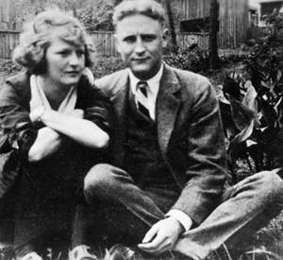
F. Scott Fitzgerald
Entered World War I in 1917
Commissioned as second lieutenant
Met and fell in love with Zelda Sayre
Had one daughter—Scottie
Published first novel (This Side of Paradise) in 1920
Moved to France in 1924

Slide 10
F. Scott Fitzgerald
Wife has extramarital affair
Wrote approximately 160 short stories during this time to supplement income
Wife committed to institution for alcoholism
Went to Hollywood to write screenplays
Did not complete his last novel (The Last Tycoon)
Died in 1940 after battling alcohol and heart attacks

Slide 11
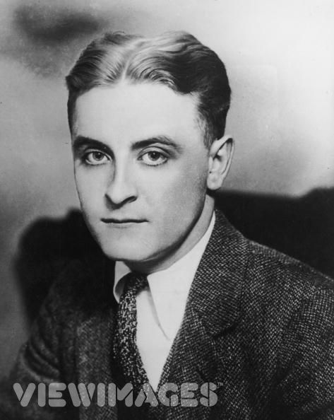
F. Scott Fitzgerald
Regarded as spokesman for the “Lost Generation” of the 1920s
Created a vision of what he wanted to become
Worked to actualize that vision
Became the embodiment of the American Dream
Has been called America’s greatest modern romantic writer
Works reflect the spirit of his times, yet they are timeless
Offered great insight into the American experience

Slide 12
The Great Gatsby
Published in 1925
Nine chapters; written in first-person
Hailed as an artistic success
Examines the Jazz Age generation’s adherence to false material values
Exposes the moral irresponsibility of the affluent in 1920s American society
Foretells the disillusionment with the American Dream
Strongly contrasts innocence with experience and ideals with reality

Slide 13
America during the 1920s
Experienced a cultural and lifestyle revolution
Stock market boomed
The wealthy spent money on lavish parties and expensive acquisitions
Automobile became the symbol of wealth
Profits made both legally and illegally

Slide 14
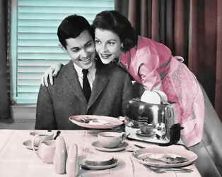
The American Dream
The idea one can achieve financial success through hard work, courage and determination
Values held by many European immigrants; passed down to subsequent generations
Unifies America despite racial, political, socio-economic and religious differences
Connects the generations of the past to those of the future

Slide 15
Origins of the American Dream
European explorers and the Puritans—Doctrine of Election and Predestination
The Declaration of Independence—life, liberty, and the pursuit of happiness
American Revolutionary War—promise of land ownership and investment
Industrial Revolution—possibility of anyone achieving wealth and the nouveau riche
Westward expansion and the Gold Rush
Immigration

Slide 16
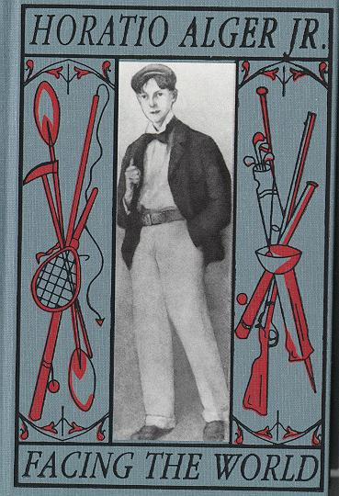
Origins of the American Dream:
Popularized by prolific dime novel writer Horatio Alger, Jr. during the late 1800s
Wrote novels that idealized the American Dream
Rags-to-riches stories
Glorified the notion that the down-and-out could still achieve wealth and success
Offered optimistic and hopeful stories
Helped entrench the American Dream with popular culture

Slide 17
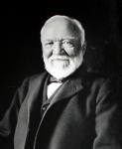
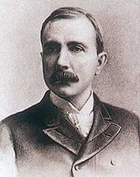
The American Dream during the 20th Century
Major industrialist personalities became symbol of American Dream
Many had humble origins and later controlled major corporations and wealth
Andrew Carnegie and J.D. Rockefeller among the most prominent
Demonstrated that intelligence and hard work breed success

Slide 18
The American Dream Today
What the American dream has become is a question under constant discussion
For some, still a viable element of life; for others, only an illusion
Majority believe that it has led to an emphasis on material wealth as a measure of success and/or happiness
Consequently morphed into “get rich quick” schemes
Many believe the Dream is dead; however, many still work for it

Slide 19
What do these images suggest about the American Dream?
Look at the following slides:

Slide 20
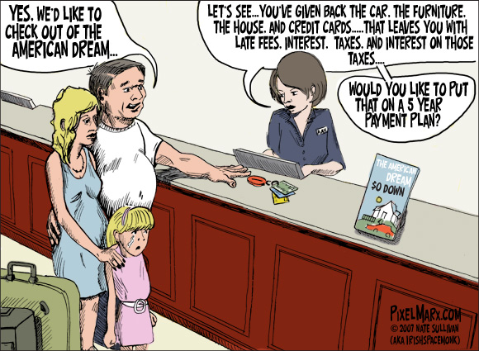

Slide 21
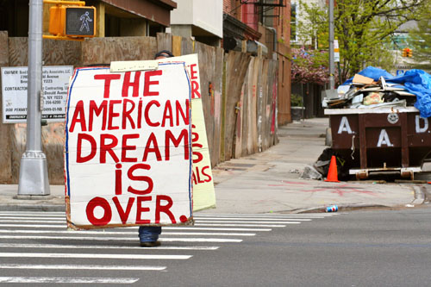

Slide 23
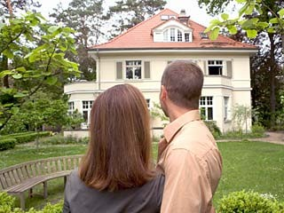

Slide 24
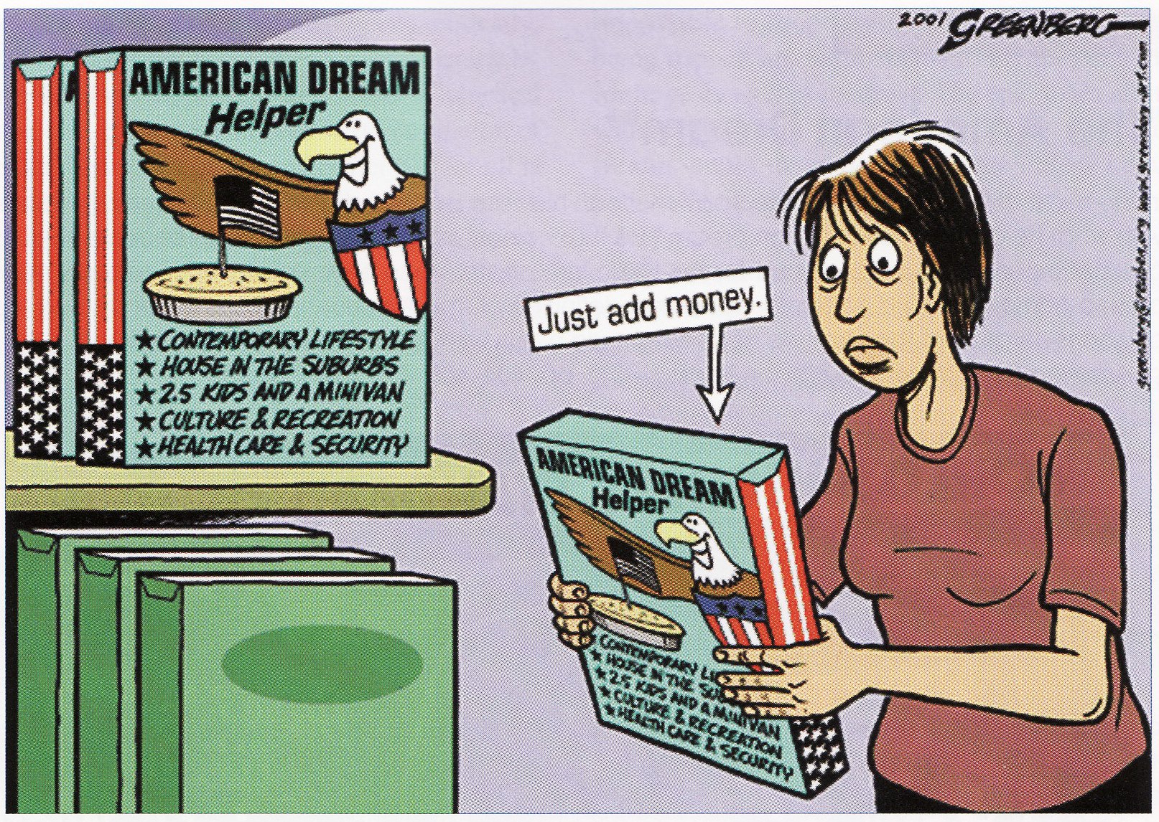

Slide 25
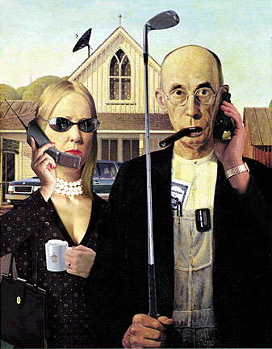

Slide 26
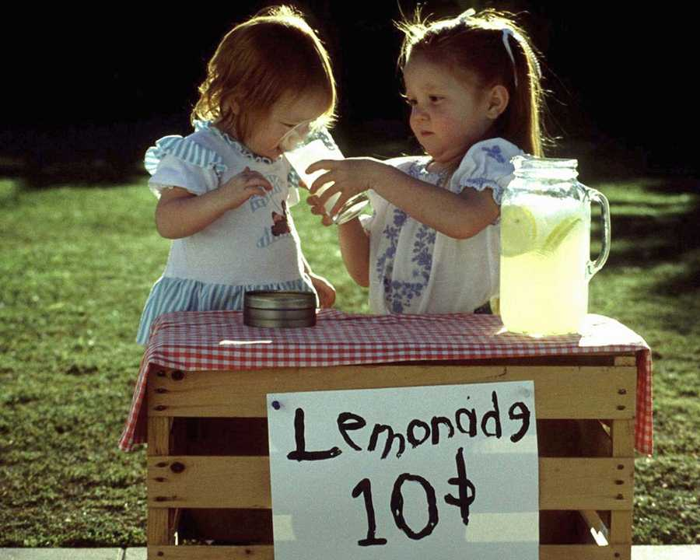

Slide 27
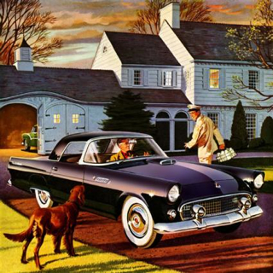

Slide 28
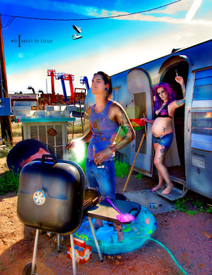

Slide 29
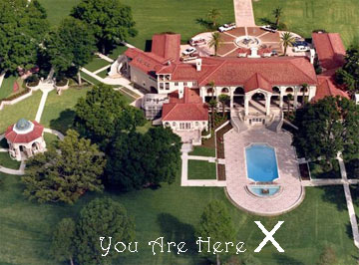

Slide 31
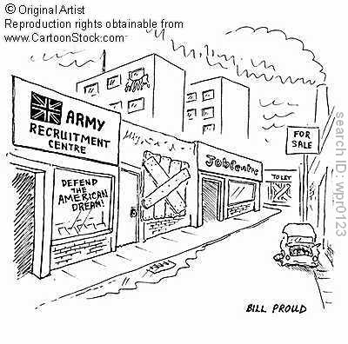

Slide 32
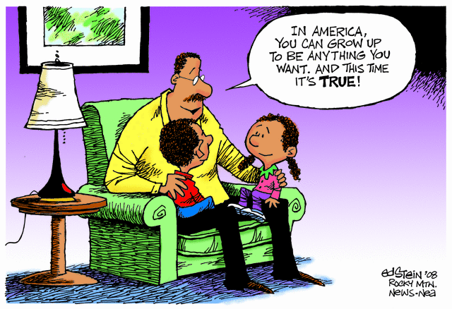

Slide 33
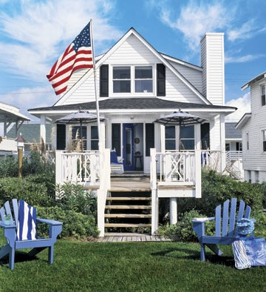

Slide 34
